Slide 1


PEOPLE'S COMMITTEE OF BINH CHANH DISTRICT
TAN NHUT 6 primary school
to
Ms Trâm’s lesson

Slide 2


Slide 3


Slide 4
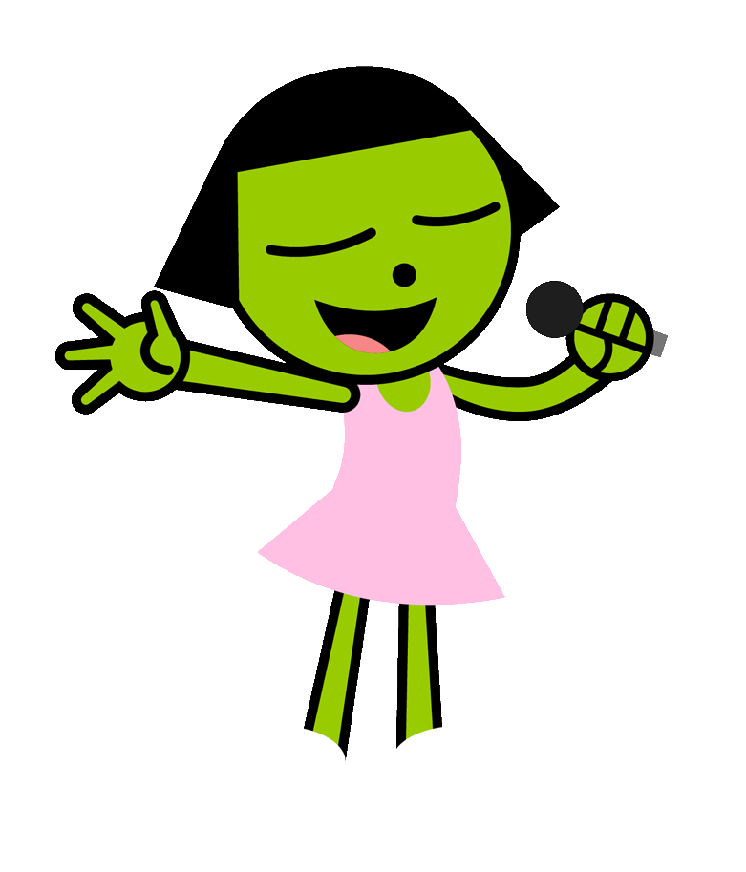
Listen and sing

Slide 5


Slide 6
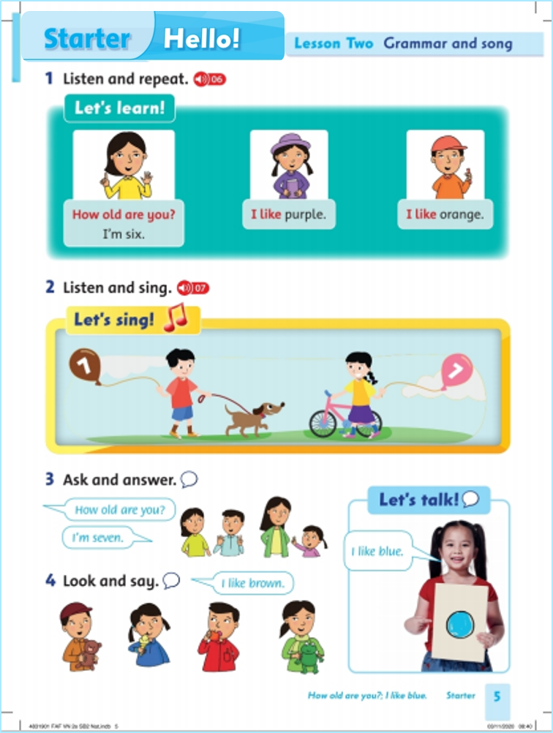
Unit Starter
Hello!
Lesson 2
Grammar and song
Page 5

Slide 7

Listen and repeat

Slide 8


Slide 9
Listen and sing

Slide 10
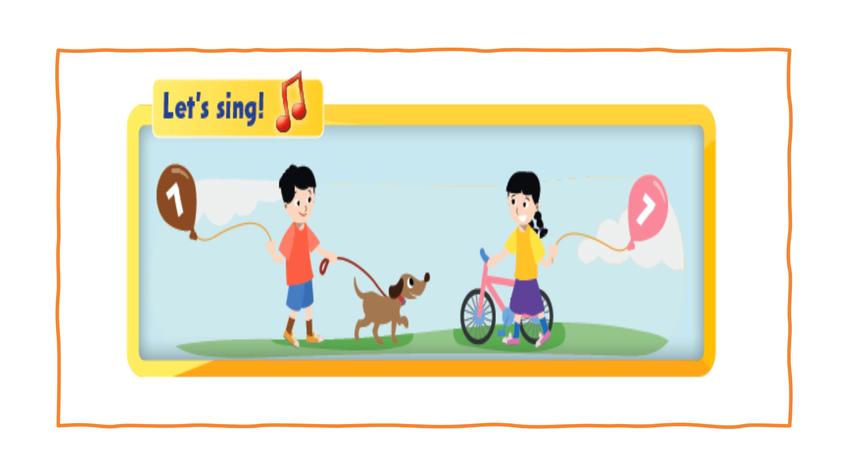

Slide 11
Ask and answer

Slide 12
Look and say

Slide 13
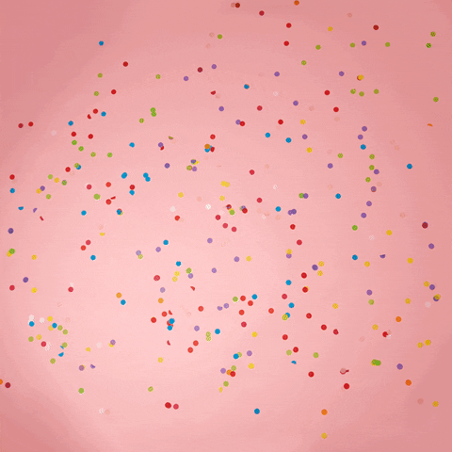
It’s play time!

Slide 14

What’s the color?
purple
orange
blue
red

Slide 15

What’s the color?
red
yellow
black
green

Slide 16

What’s the color?
green
purple
orange
black

Slide 17

What’s the color?
blue
red
yellow
purple

Slide 18
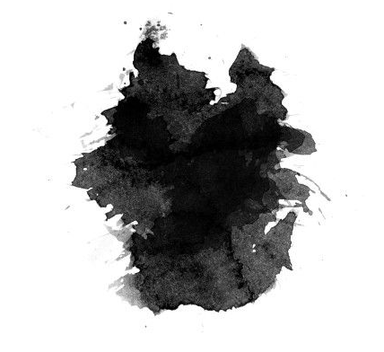
What’s the color?
green
red
blue
black

Slide 20


Slide 21


